Slide 1
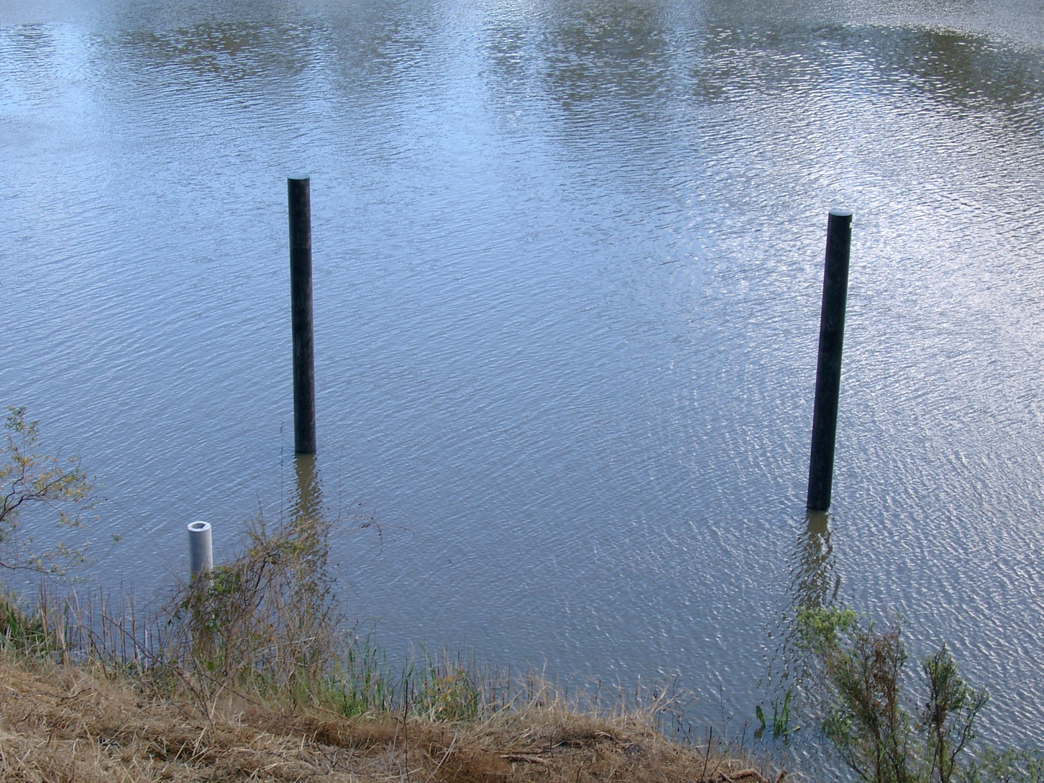
Farewell to the Pontoon

Slide 2
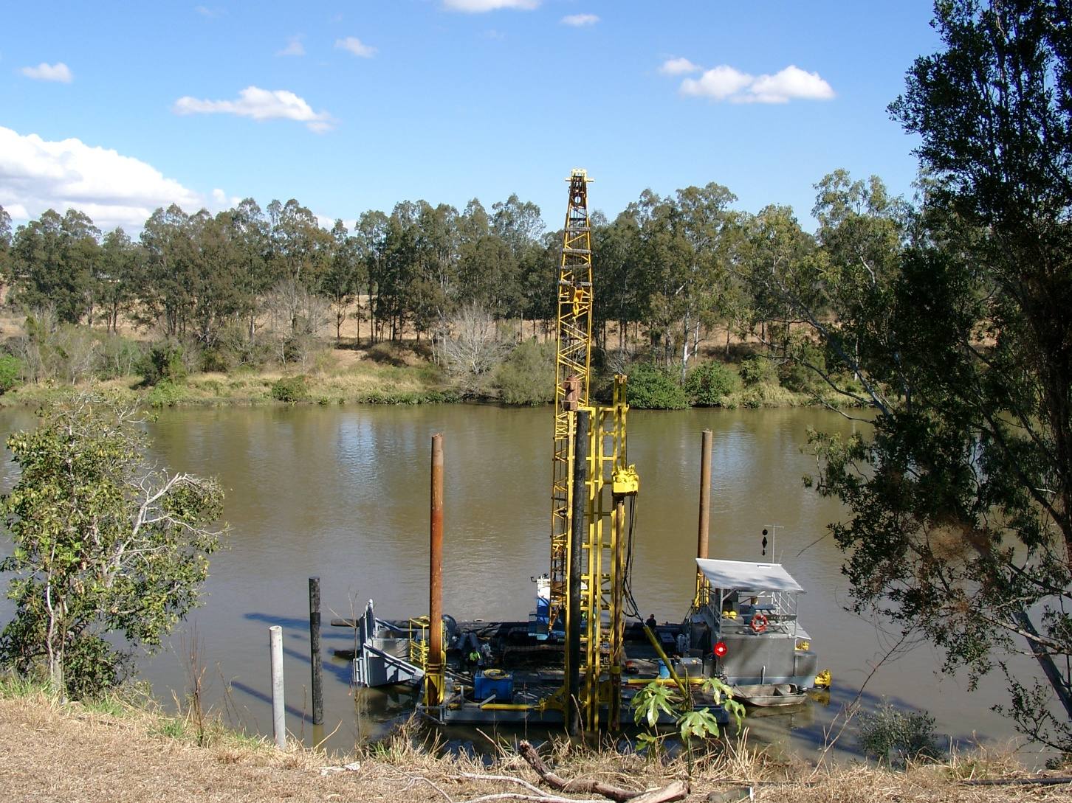
Pontoon being built in August 2004

Slide 3
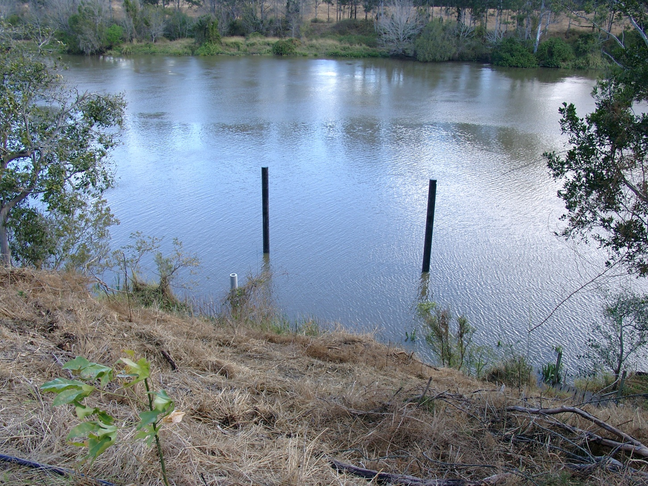
The pylons and support for walkway
Looking down from top of the bank which has been
cleared and planted up.

Slide 4
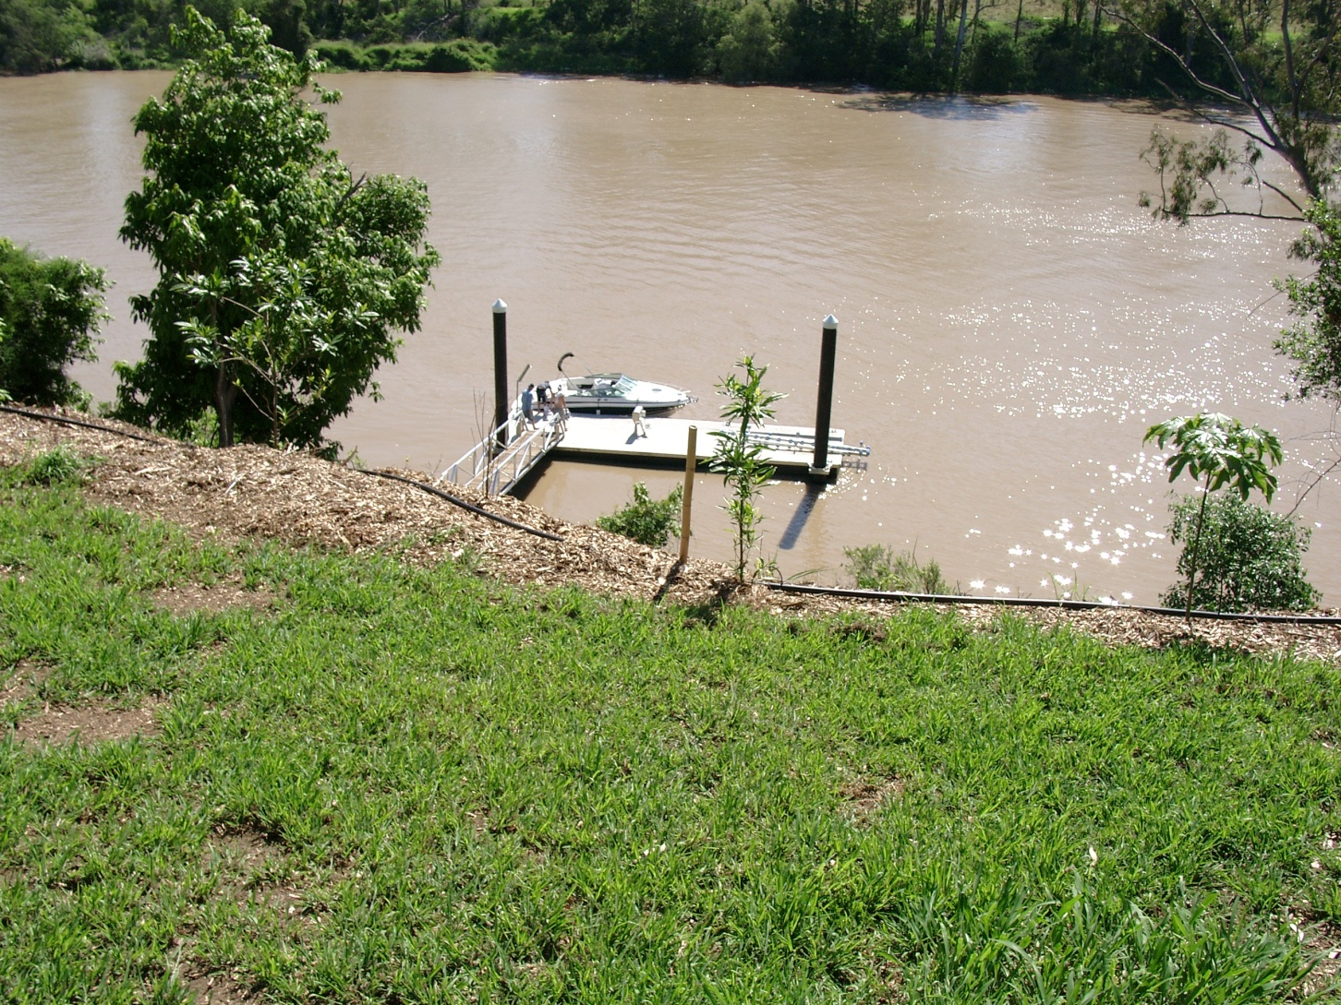
The full package of pontoon, walkway and boat

Slide 5
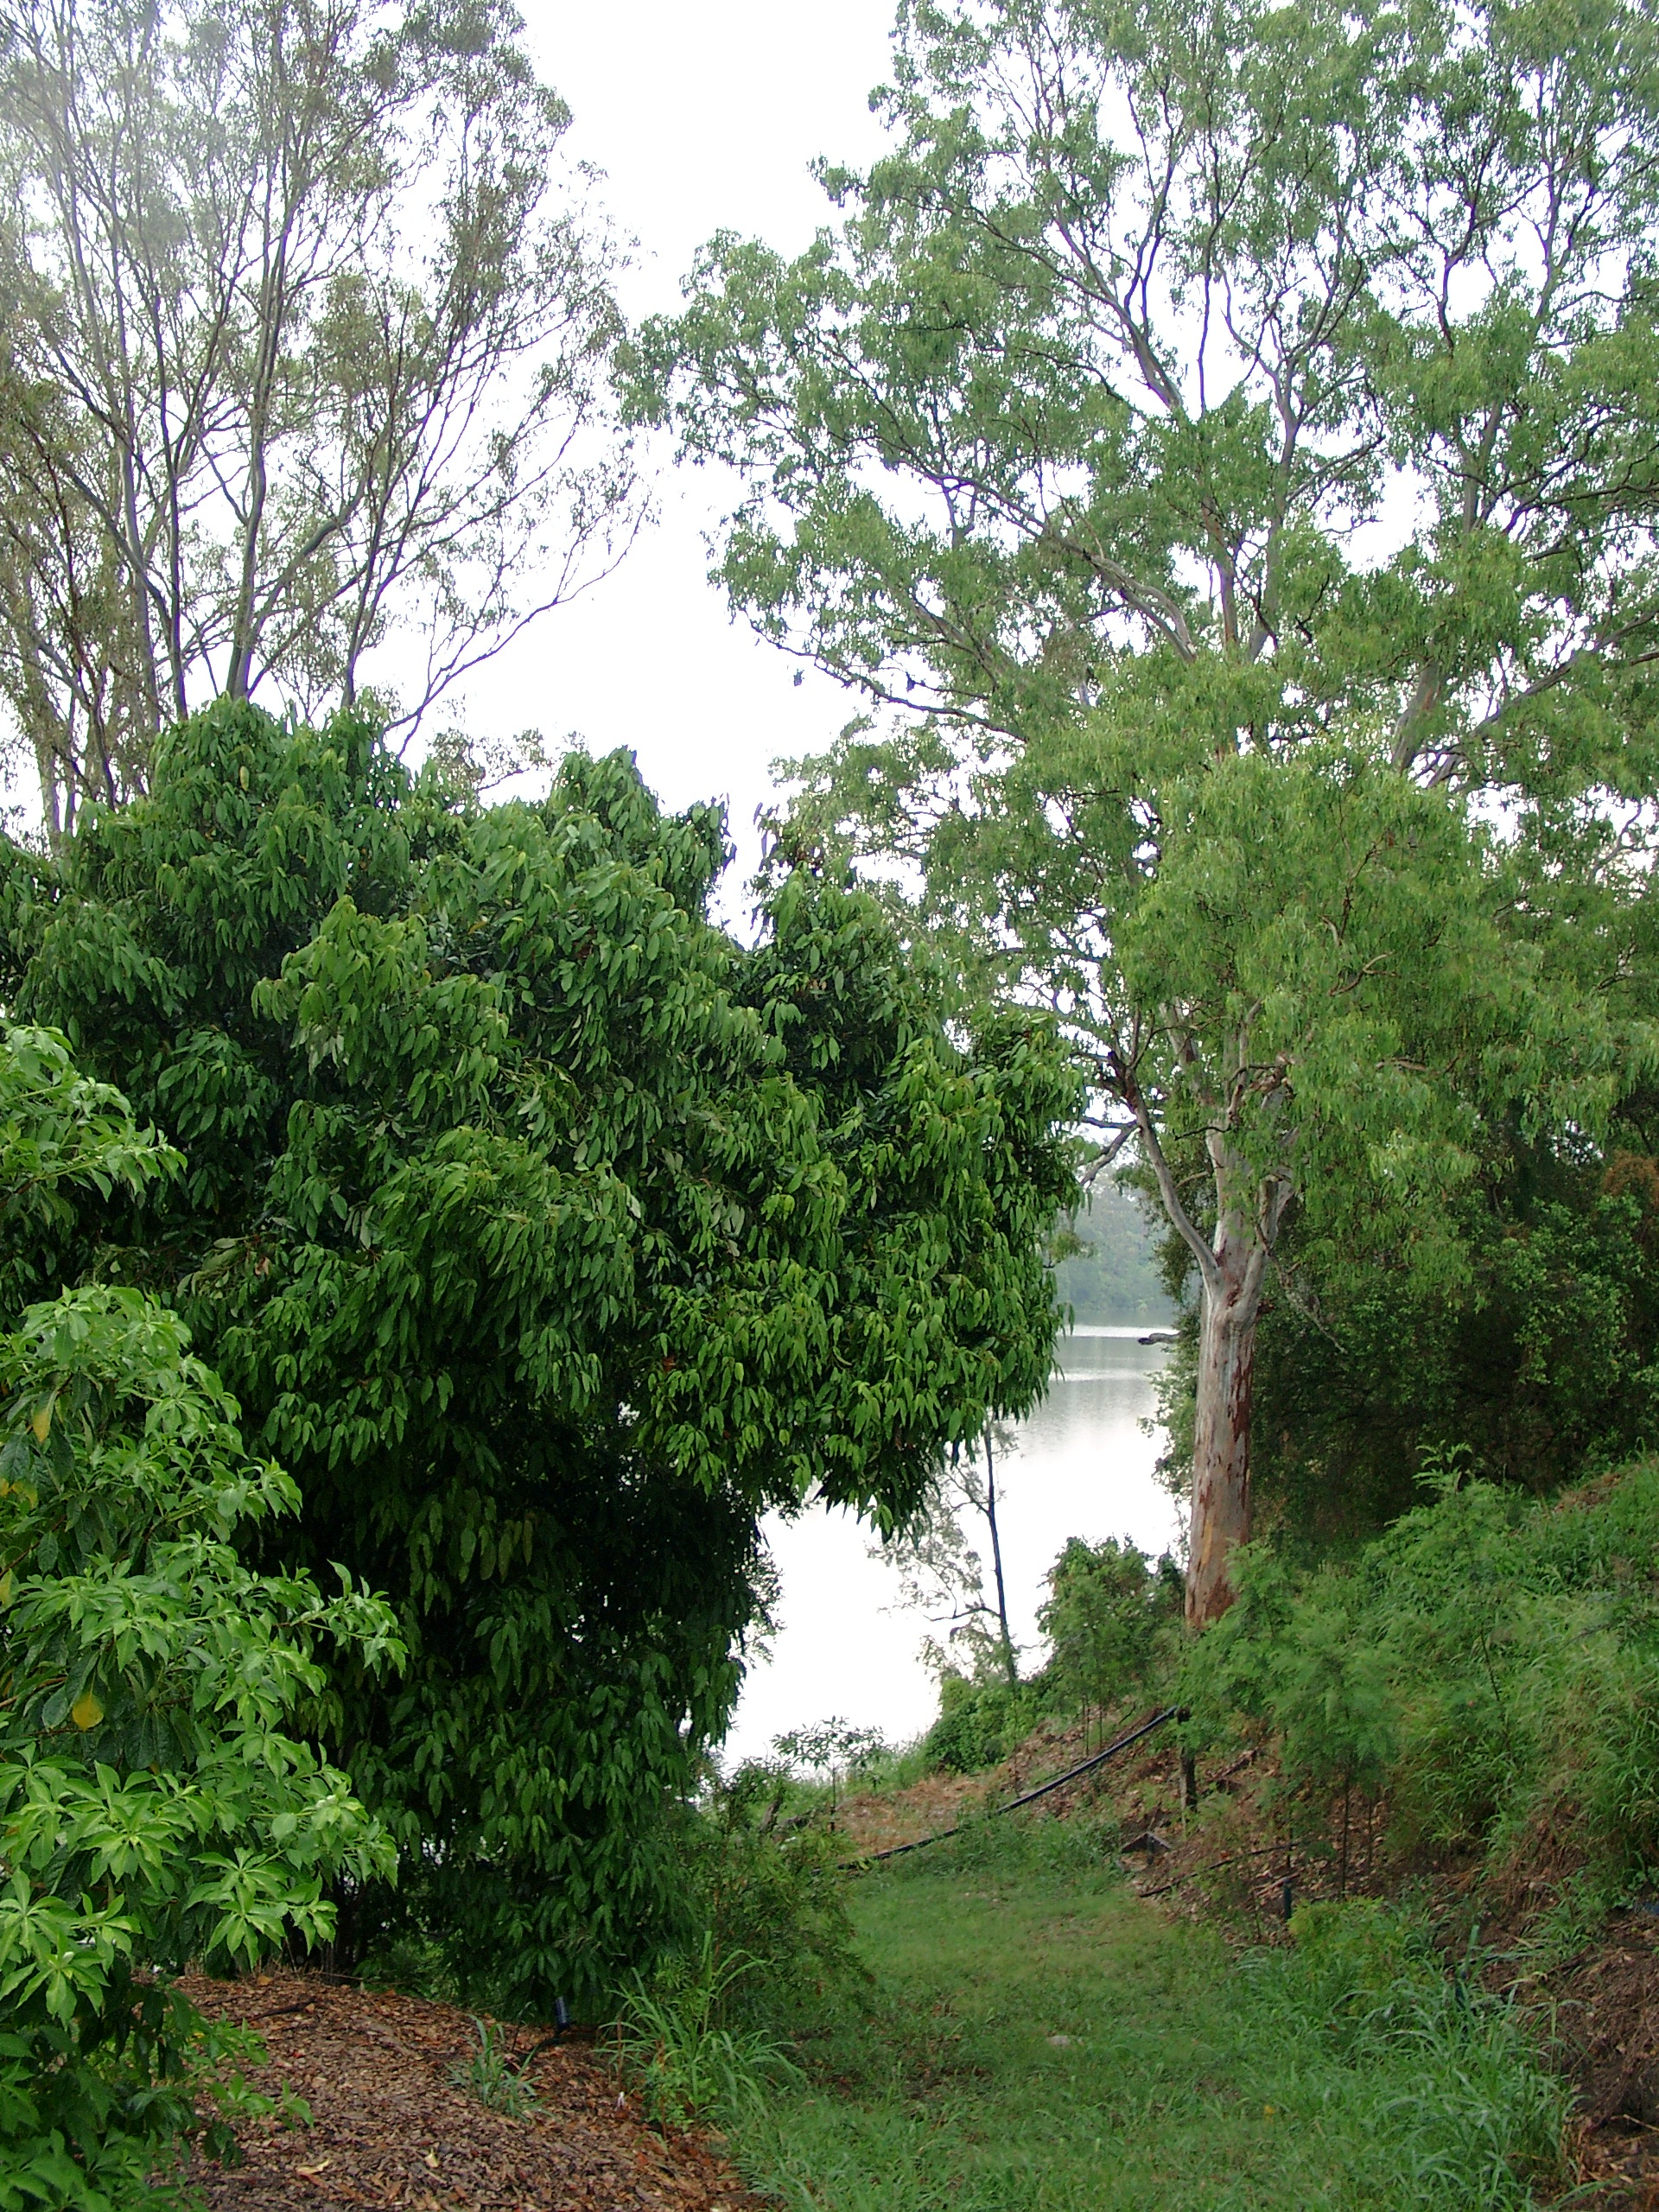
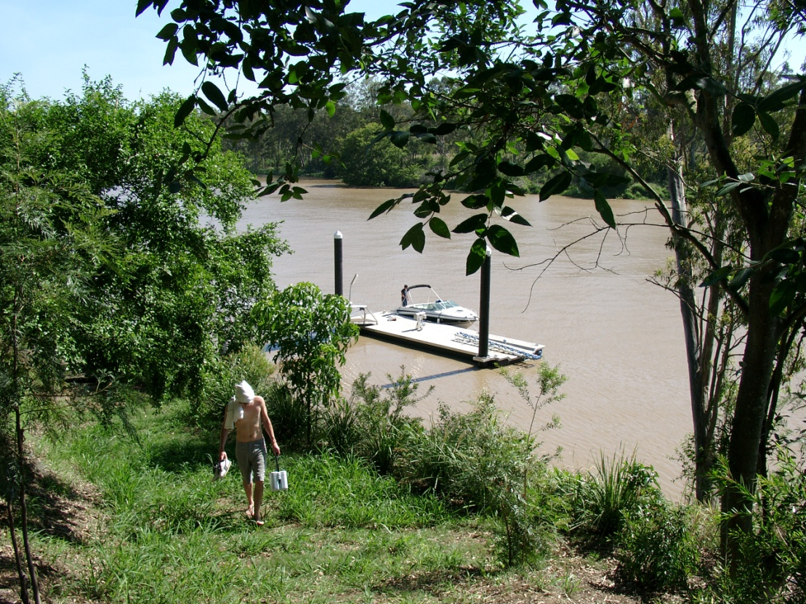
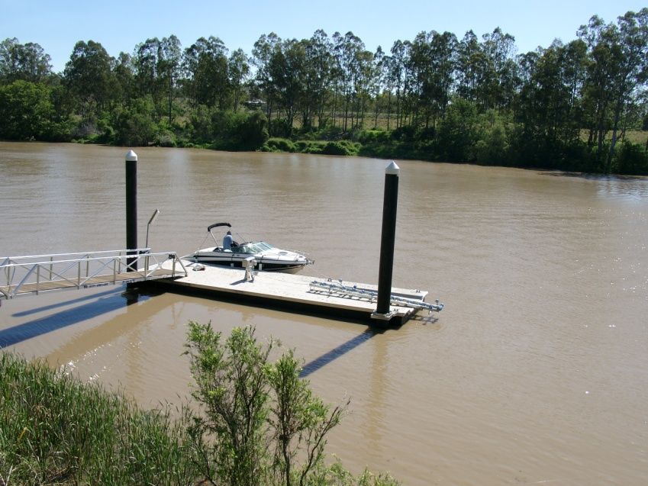
The track down to the pontoon turning left and ending in a set of stairs then connecting to a path onto the walkway.

Slide 6
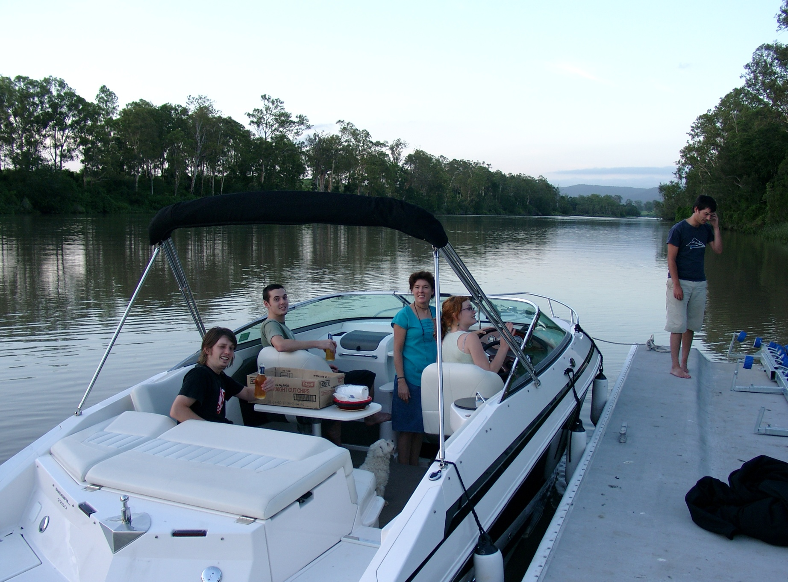
The beautiful Moggill stretch looking upriver from the pontoon

Slide 7
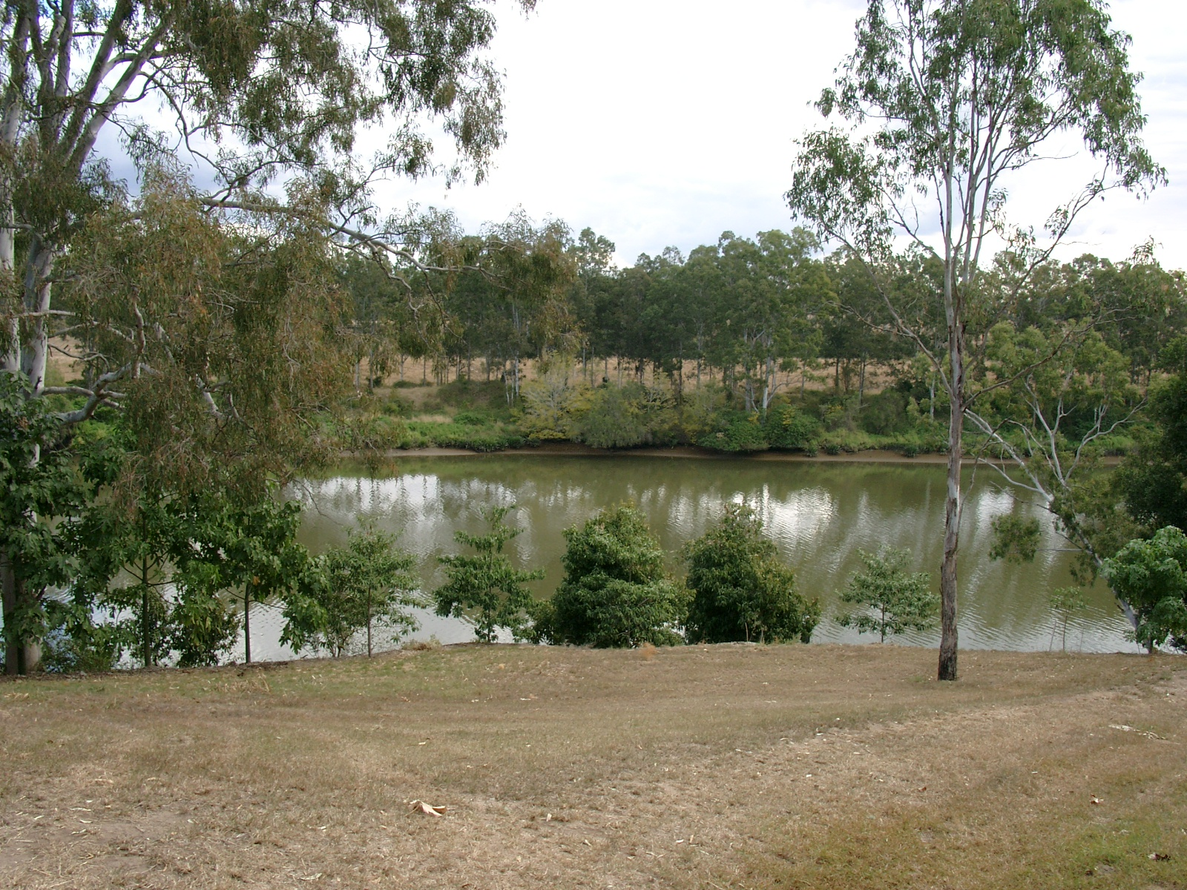
The view from the gate in 2004
Note this young eucalypt

Slide 8
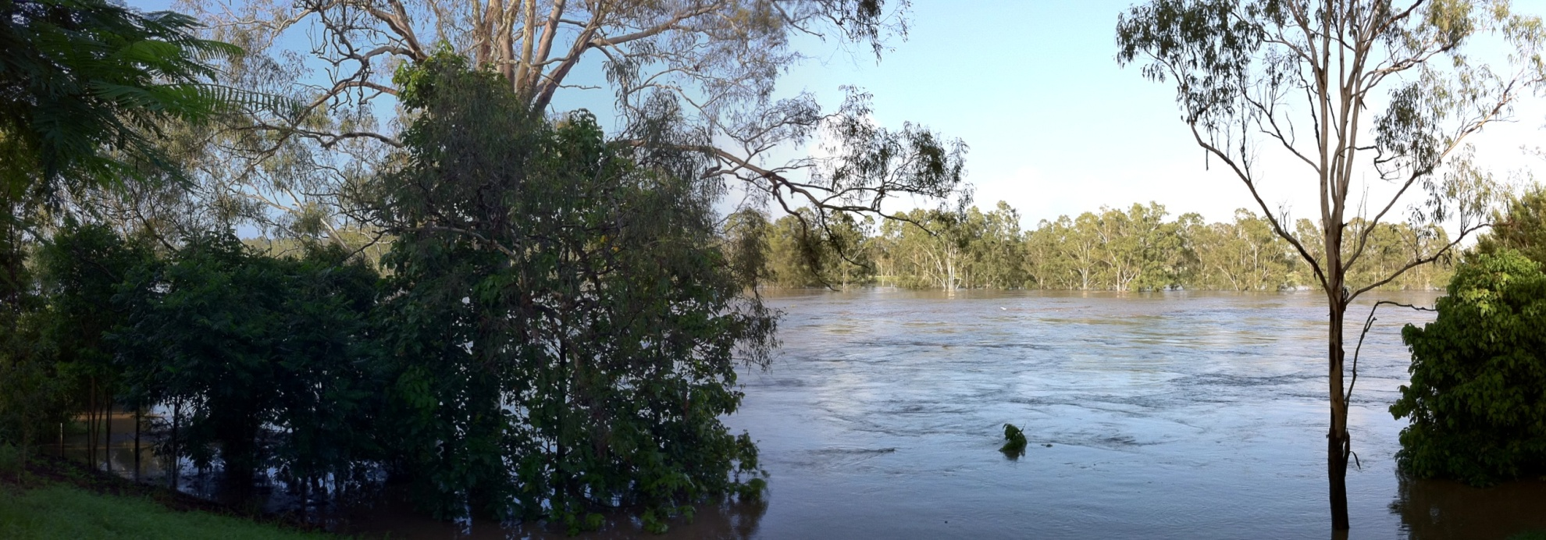
The height of the flood at the same place

Slide 9
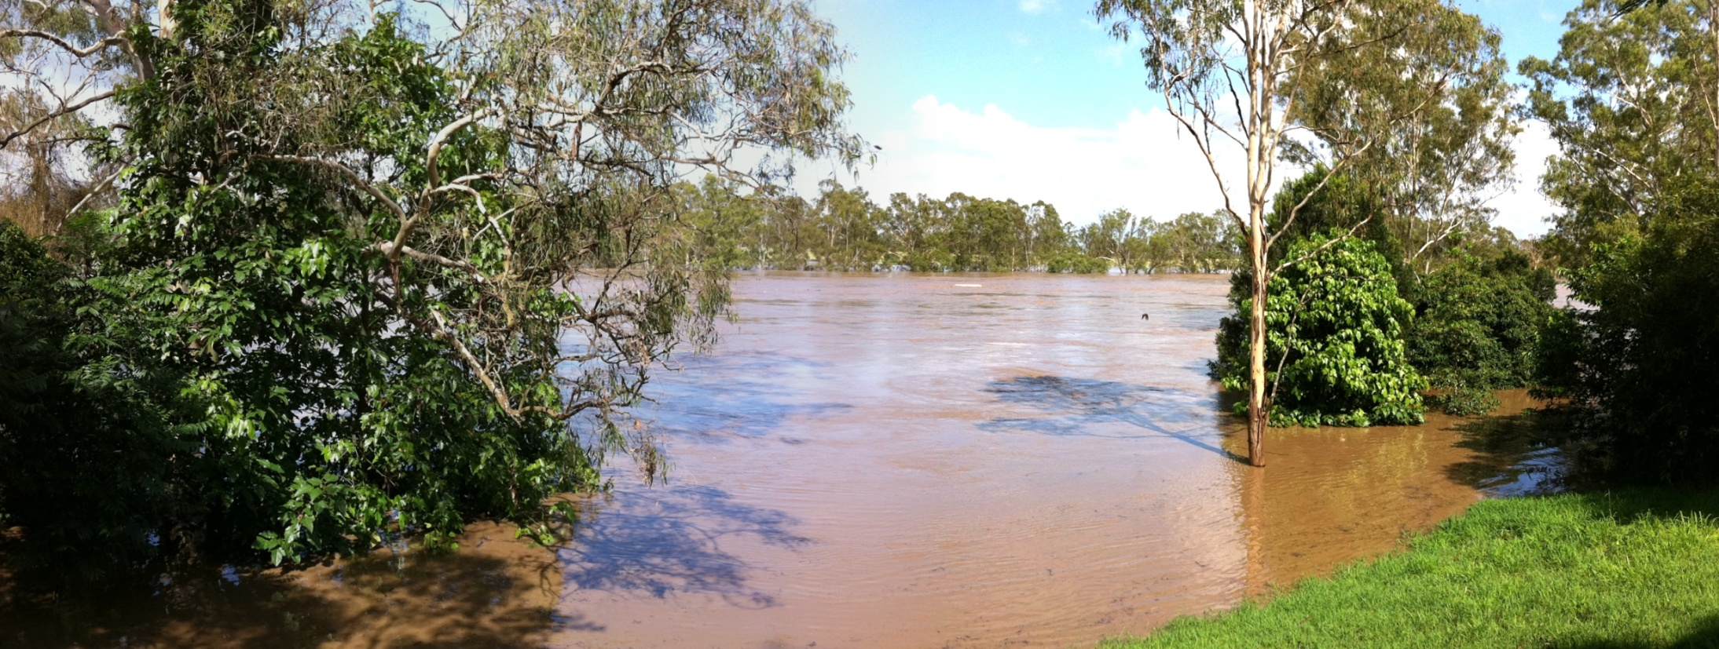
The young eucalypt from another angle

Slide 10
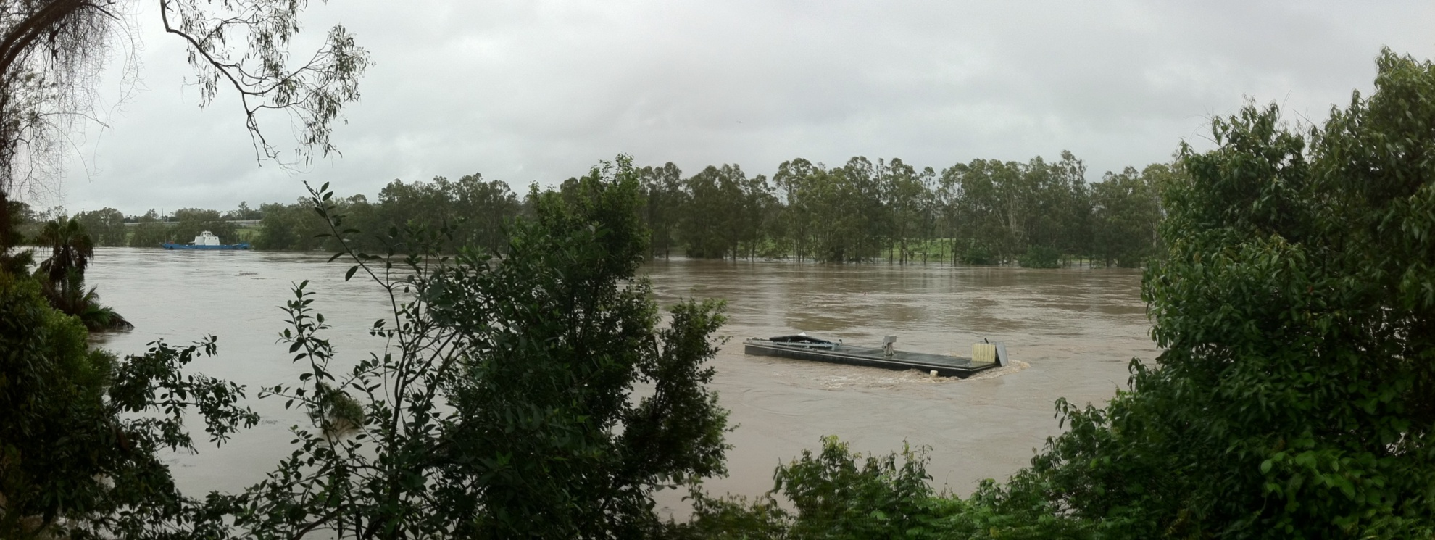
Pontoon last seen on its way to Moreton Bay.
Note Moggill Ferry in left background.

Slide 11
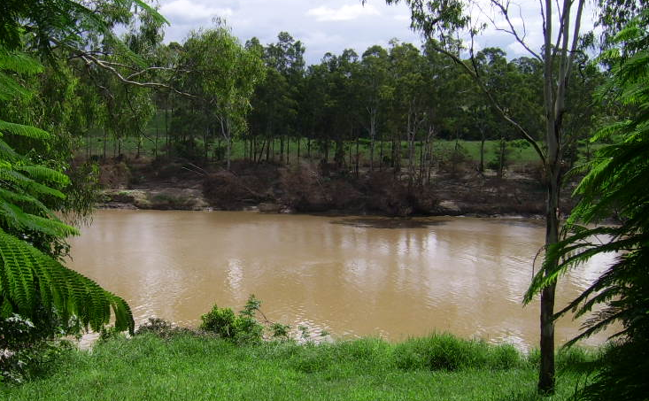
Extreme devastation on opposite bank

Slide 12
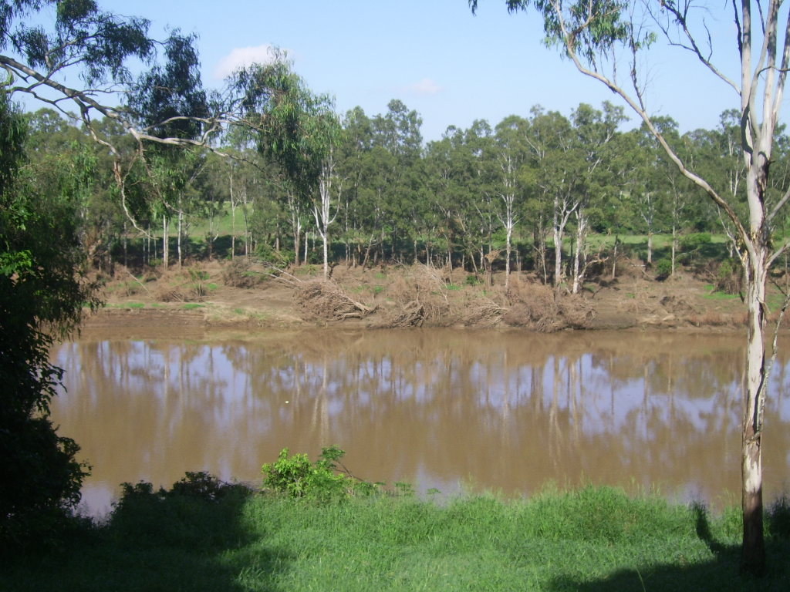

Slide 13
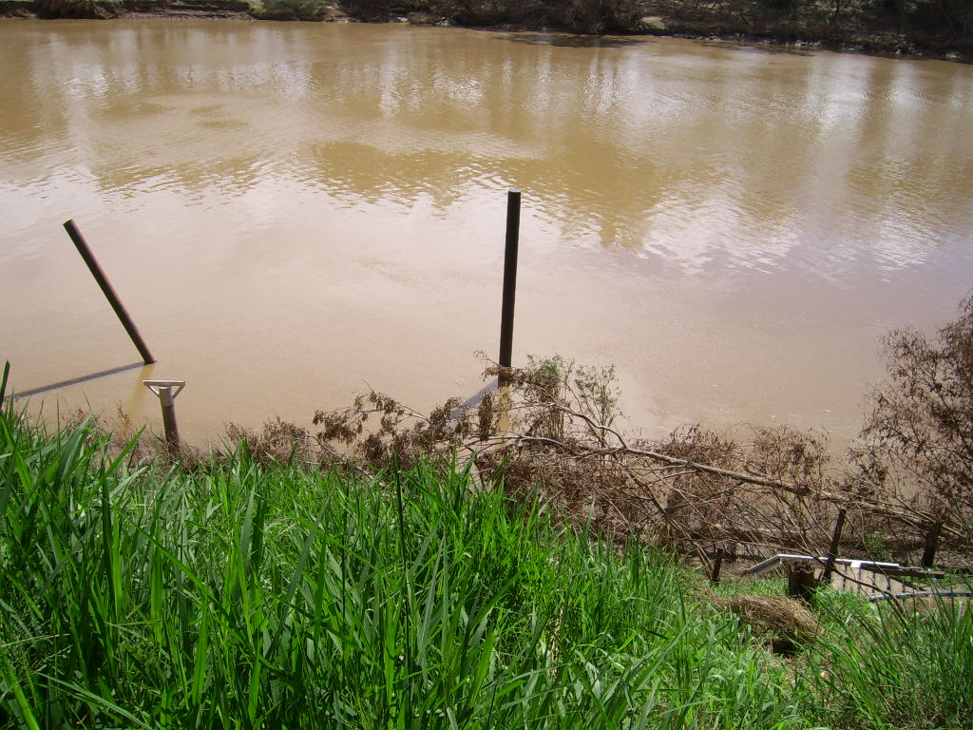
The view from the top of the bank now

Slide 14
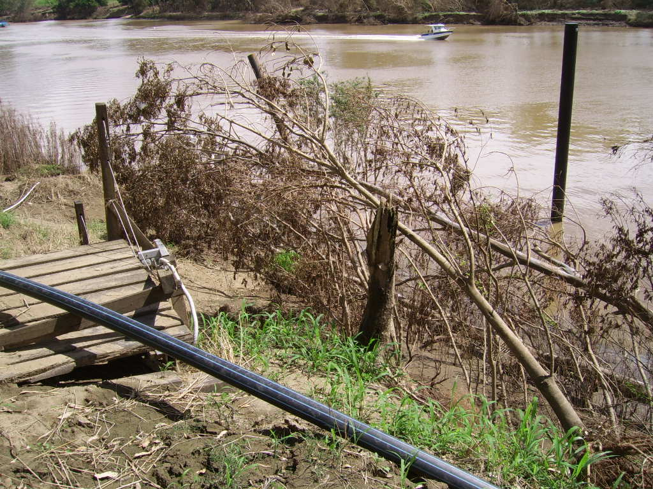
What’s left of the pontoon

Slide 15
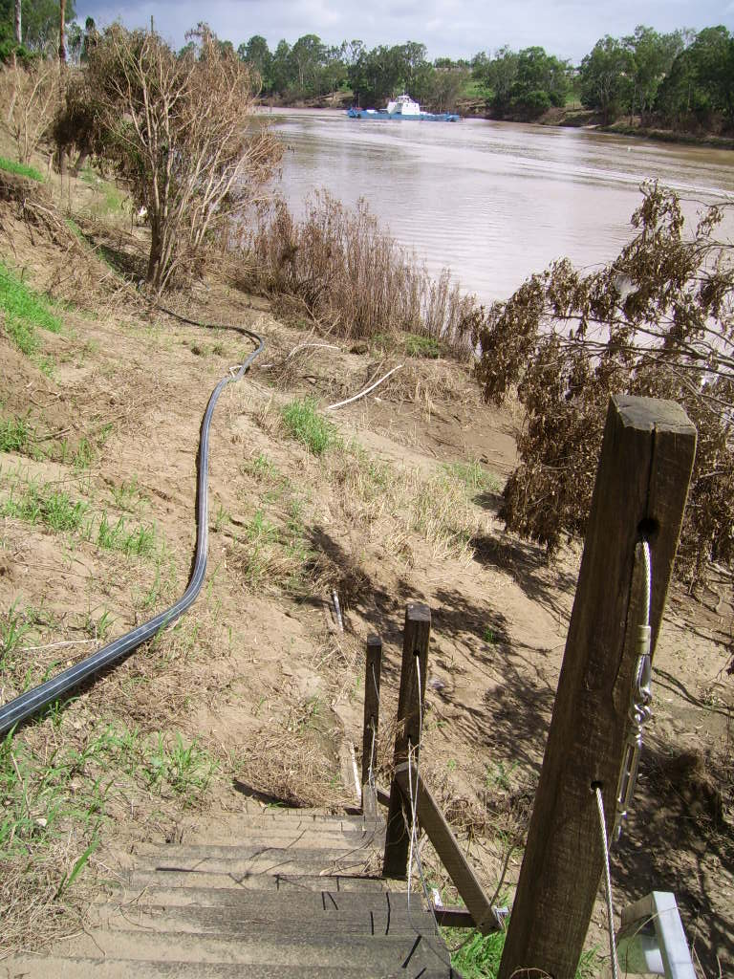
The sandy beach that was deposited where the walkway to the pontoon used to be.

Slide 16
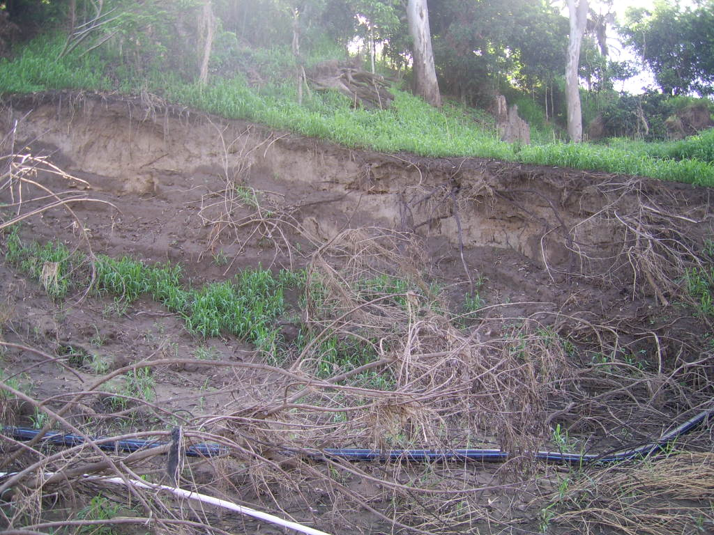
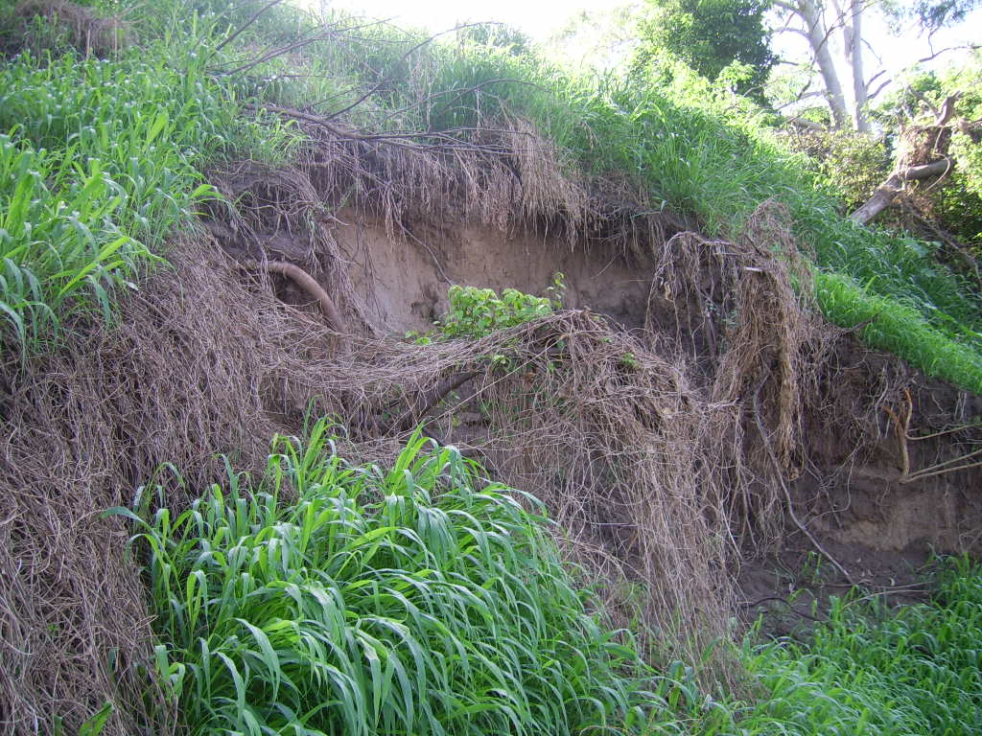
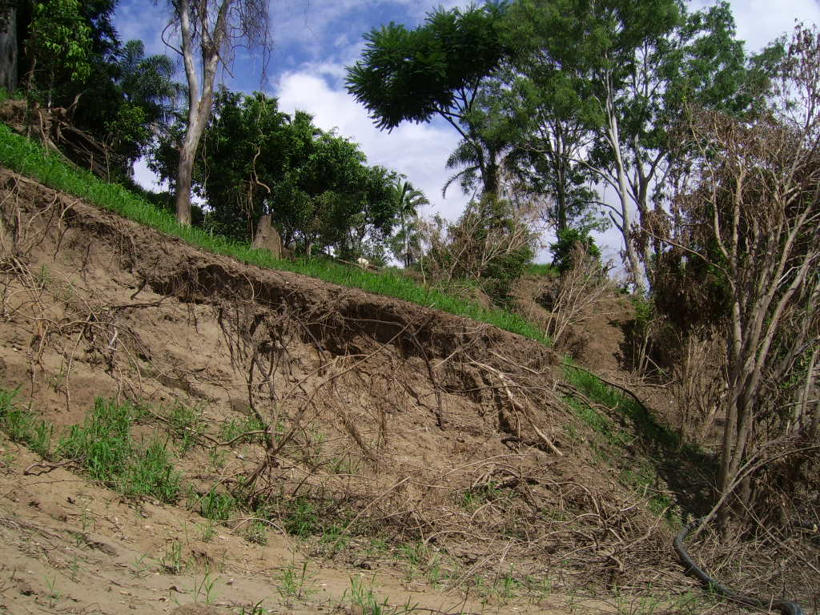
Three major collapses to the riverbank near the pontoon area.

Slide 17
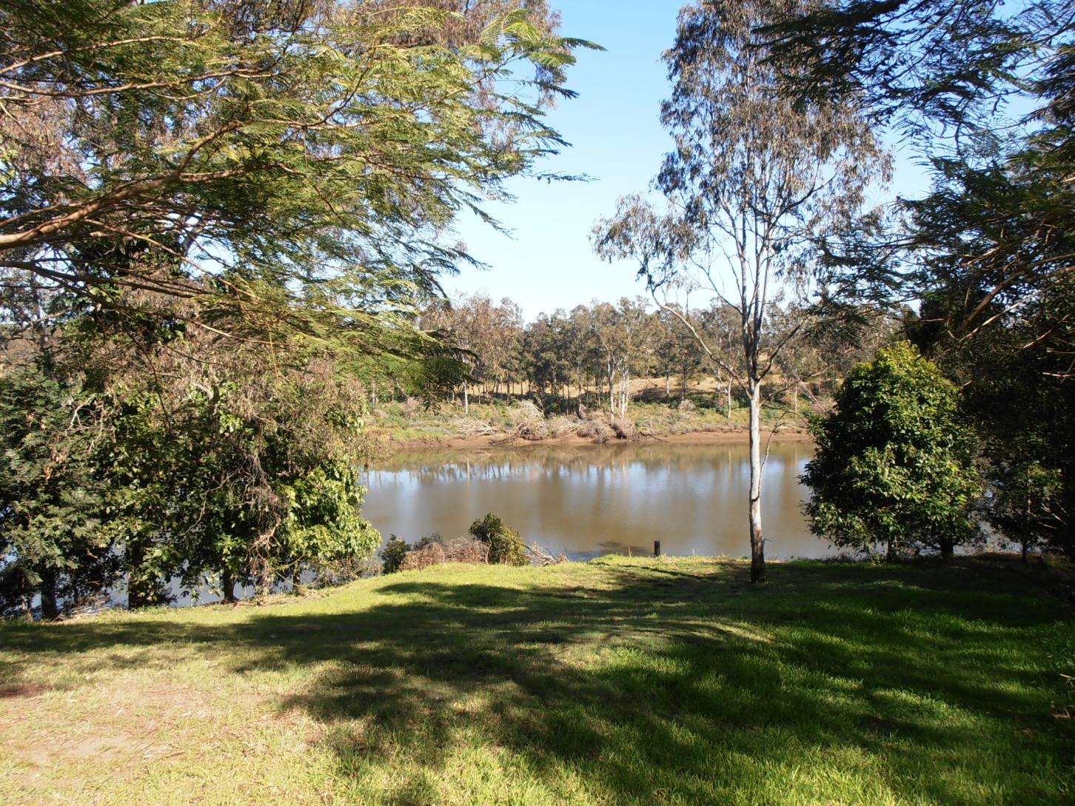
The view of the top of the pontoon bank one year after the flood
Top of left pylon

